Slide 1
High Brightness Electron Sources
Ivan Bazarov
Cornell University
Outline
Brightness limits
What we want
Holistic approach to injector design
Some promising directions

Slide 2
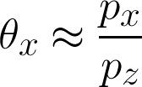
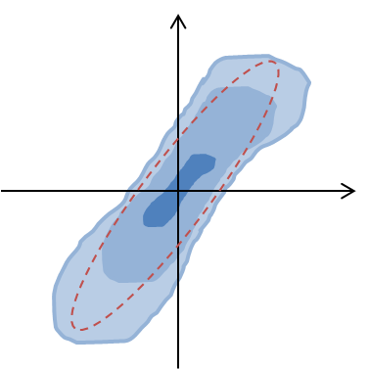

Key Points of Impact / Definitions
Key Points of Impact
In photoemission sources: minimize MTE & maximize E-field
–E_{z} (sets max charge density)
electron beam
coherence length
electrons
Photocathode
Laser
Definitions
Brightness = particle density in (6D) phase space
Emittance = phase space volume (area) occupied
at beam waist

Slide 3
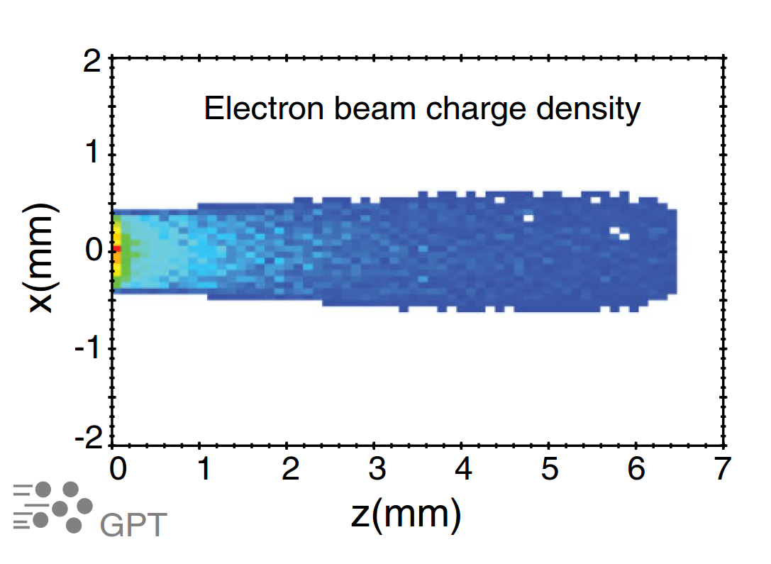
Brightness limit at the cathode
PRL 102, 104801; PRSTAB 17, 024201
Aspect ratio:
A >> 1 (Pancake)
A ≤ 1 (Cigar)
min laser spot:
v
laser duration
Important when:
Large charges
Moderate gradients
Shortest pulses
Small charges (e.g. UED)
High gradients

Slide 4

Best MTE’s today
$$MTE=\frac{1}{2}mv_{⊥}^{2}$$
emittance
1 eV
1.4 um / mm-rms
Log-scale
Practically used MTE’s
Metals
  25-40 meV near threshold
  Very low QE<10⁻⁷.
Alkali-antimonides
  25-40 meV near threshold
  Low QE <10⁻⁴.
GaAs/(Cs,O)
  25-40 meV near threshold
  Very long response time
100 meV
0.44 um / mm-rms
Why this limit??
10 meV
0.14 um / mm-rms
MTE limited by disorder induced heating (DIH)
1 meV
0.04 um / mm-rms

Slide 5
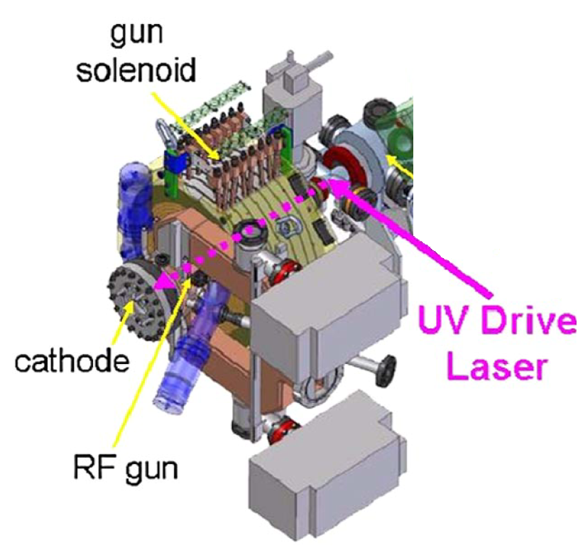
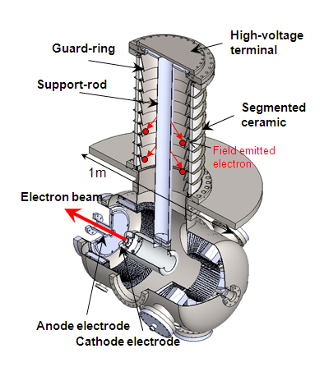
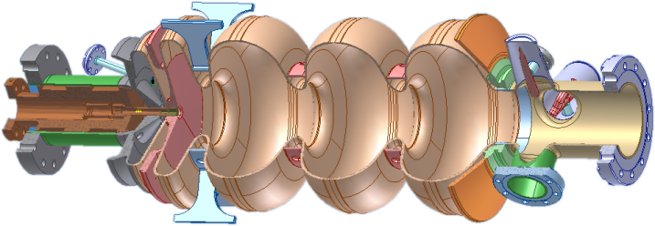
“There once were three great whales that upheld the earth...”
NCRF gun
HVDC gun
SRF gun
plus variants...
Each technology forces one to adopt other (not so pleasant) things:
  E.g. heat or vacuum management in NCRF;
  Use of moderate gradients in DC guns;
  Their own specific challenges in SRF guns...
½ cell
Tuner
RF / HOM ports
Cathode
stock
Choke filter
3 full cells

Slide 6
Available Gradients at the Cathode
0
10
20
30
40
50
60
70 MV/m
DC
small gaps
SRF
NC RF (pulsed)
NC VHF ¼-wave
vacuum:
Excellent
Very Good
OK

Slide 7
What we’d like:
Let’s use as a figure of merit.
So far we have:
~100 MV/m/eV essentially for all existing gun technology choices (great cathode but poor E-field or vice-versa)
Instead we want simultaneously:
Gradient at the cathode: ~100 MV/m (not just peak!)
MTE of the photocathode: ~1 meV (as set by DIH)
This would give us ~100,000 MV/m/eV or 3 orders of magnitude increase in transverse brightness

Slide 8
Holistic approach to design
Essential when designing high-brightness electron sources in the new parameter range;
Modeling of space charge is mature & agreement with experiment is excellent;
  Exceptions: complicated photocathode geometries (a.k.a. tips), poor understanding of the connection between the cathode’s surfaces and MTE’s at high gradients (i.e. need measurements), disorder-induced heating being a specialty, etc.
Multiobjective optimizations are essential to observe tradeoffs; examples of this approach:
  For UED parameters: with cryo-cooled DC gun (arXiv:1510.07738), high gradient NCRF (arXiv:1604.03902);
  For XFEL: LCLS-2 with NC VHF and DC guns;
  For ERL: a comparison between DC- and SRF-gun-based injectors.

Slide 9
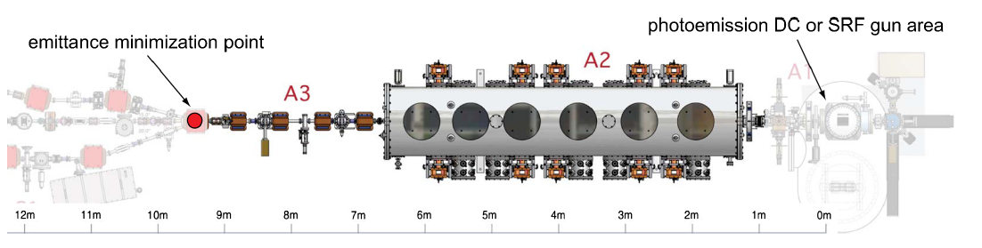
Example of a comparison of two gun technologies for ERL: DC vs SRF
GOAL: using multiobjective genetic algorithms compare two technologies
Use Cornell injector beamline as a basis
Realistically (as much as possible) constrained DC gun voltages, SRF gun fields
Vary gun geometries, laser, beam optics
PRSTAB 14, 072001

Slide 10
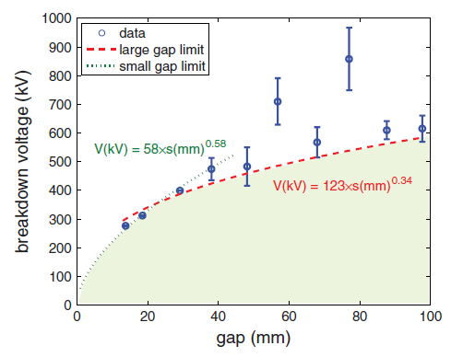
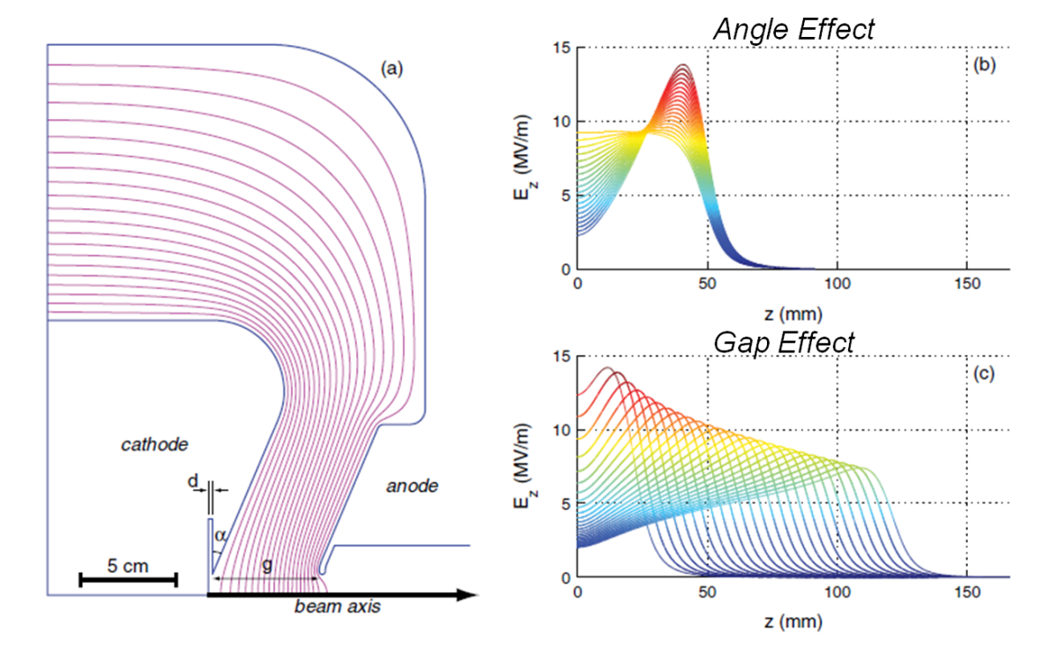
DC gun geometry & field constraints
Use empirical data for voltage breakdown
Vary gun geometry while constraining the voltage
breakdown voltage vs gap
3 geometry parameters: gap, cathode angle & recess
keep surface fields ≤ 10 MV/m

Slide 11
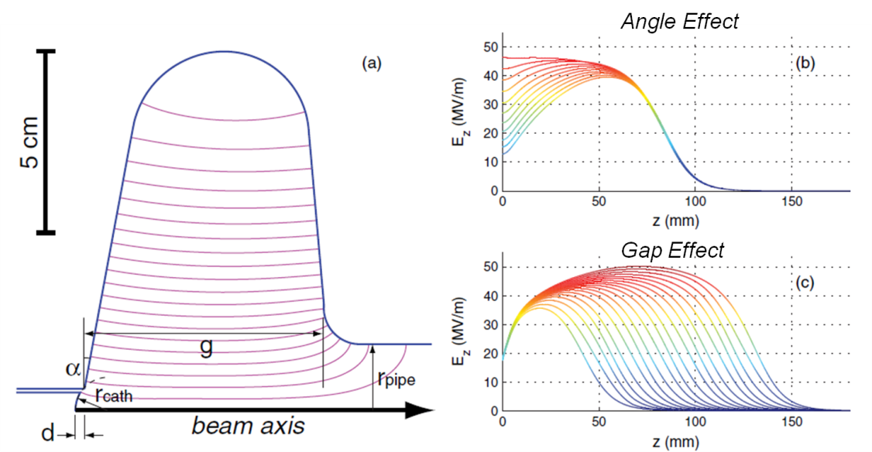
SRF gun geometry & field constraints
Equator radius used for frequency tuning
1.3 GHz 0.5-cell elliptical cavity
Constrained surface fields according to TESLA specs
  E_{acc} ≤ 25 MV/m
  E_{pk}/E_{acc} ≤ 2
  H_{pk}/E_{acc} 4.26 mT/(MV/m)
Vary beam current 0-200 mA
Final bunch length ≤ 3 ps rms
4 parameters: gap, cathode angle & recess, pipe dia
Most solutions E_{pk} ≤ 50 MV/m

Slide 12
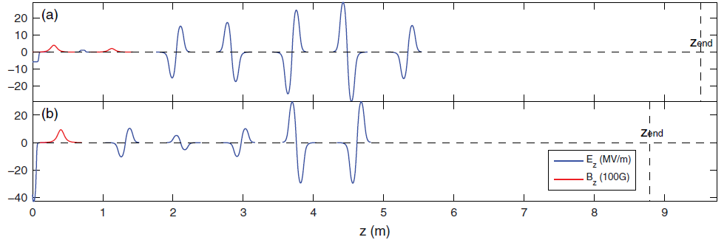
Beamline parameters
DC Gun
SRF Gun
SRF Linac
Solenoids
Buncher
The SRF beamline is simplified:
  NC buncher cavity is ineffective at high beam energy
  Only one solenoid included

Slide 13
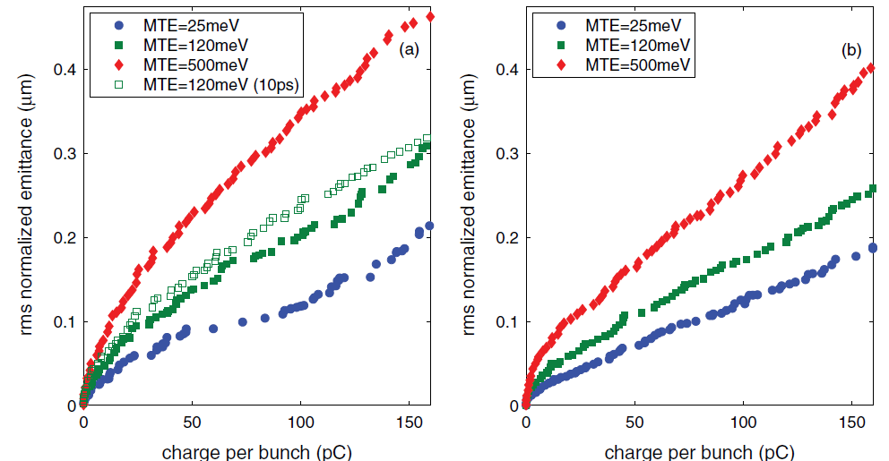
Emittance Performance
DC Gun
SRF Gun

Slide 14
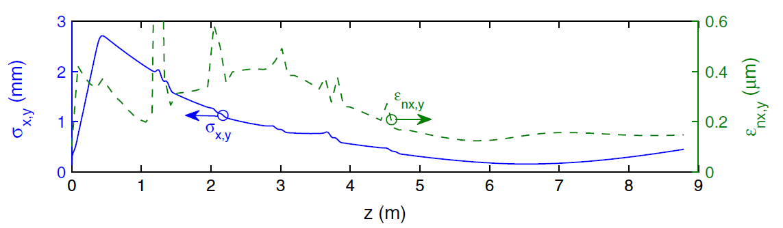
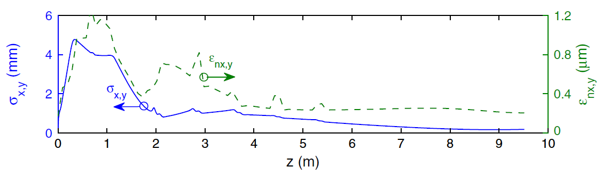
A closer look at 80pC case
SRF Gun
×2-3 larger peak emittance!
but final is very close
DC Gun

Slide 15
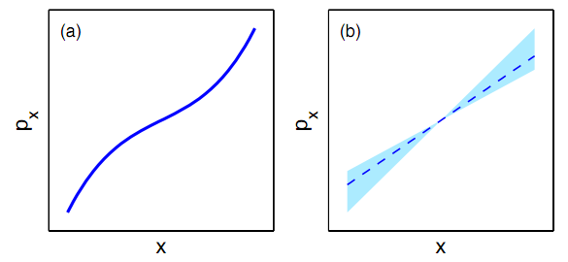
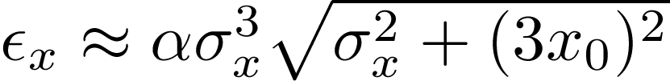
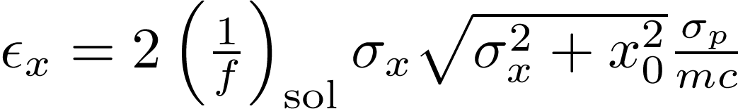
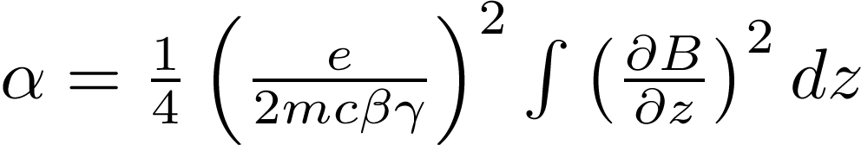
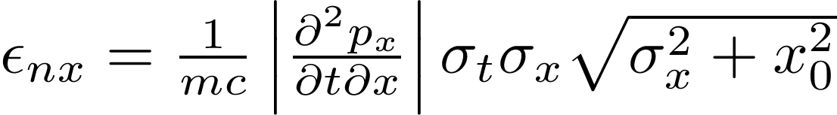
Aberrations & slice phase space corrections
aberrations
slice-induced
Solenoid geometric:
Solenoid chromatic:
RF focusing:

Slide 16
Emittance budget
Cathode field ×3 higher for the SRF
Final emittance is only ×0.7 lower
At lowest MTE’s, this difference disappears
Basically same longitudinal emittance

Slide 17
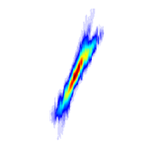
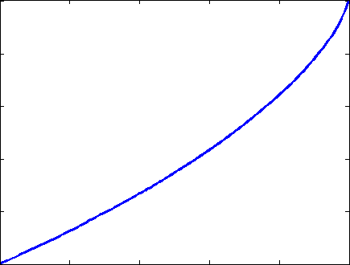
Core emittance
PRSTAB 15, 050703
0
ρ_{max}
rms emittance vs. beam fraction: ε_{nx}(ξ)
ε_{nx}(100%)
halo
p_{x}
ε_{nx}(core)
emittance
x
core
0
fraction
ξ_{core}
1
core emittance is related to the max phase space density
core fraction: how much of the beam is contained inside the core

Slide 18
Core emittance invariance
Core emittance (max phase space density) remains the same even if the forces vary along the bunch slices (e.g. space charge) as long as no slice sheering (banana) occurs (or other bad things such as DIH).
p_{x}
p_{x}
x
x
bunch slices
bunch slices
Min core emittance is set by the photocathode & the electric field. E.g. when the photocathode is improved, the core emittance (almost) always improves by the same amount.

Slide 19
Corollaries
Design (future) photoinjectors with MTE = 0
Should have capability to measure core emittance (e.g. via phase space tomography or direct mapping)
Conventional rms emittance is best replaced with ⇒ core emittance/core fraction (more stable against non-Gaussian distributions)

Slide 20
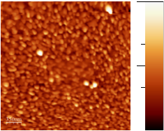
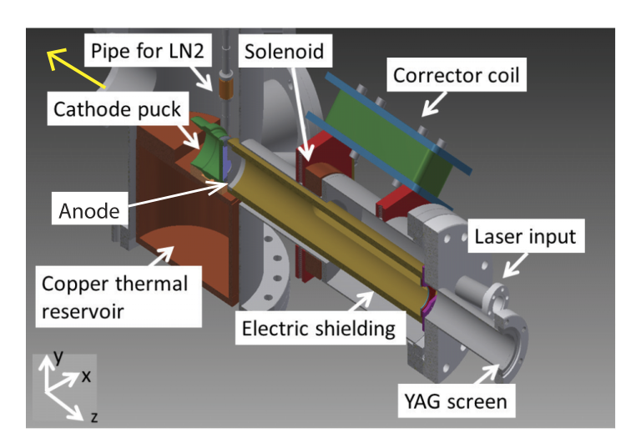
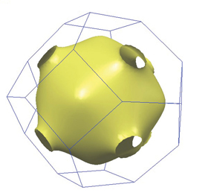
Some promising directions
Disordered polycrystalline cathodes
Current Status
Alkali antimonides
  Near perfect cathodes except for roughness
  Great recent progress (roughness down by ×10)
Goals
Demonstrate that reduced roughness translates into increased performance, esp. at high fields
Importance
  Obtain photoelectron’s transverse energy limited only by the temperature of the substrate
  E.g. use cryogenically cooled photocathodes to reduce MTE further
100 nm
25 nm RMS roughness
100 nm spatial period
K-Cs-Sb
High field, low-T MTE-meter
1 μm
0 nm
pick off electrons from the cold Fermi surface
APL Mater. 1, 032119

Slide 21
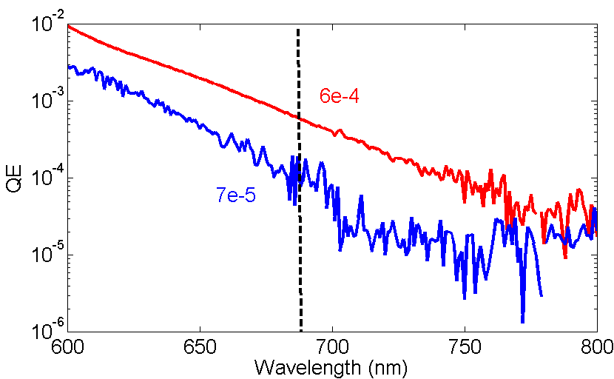
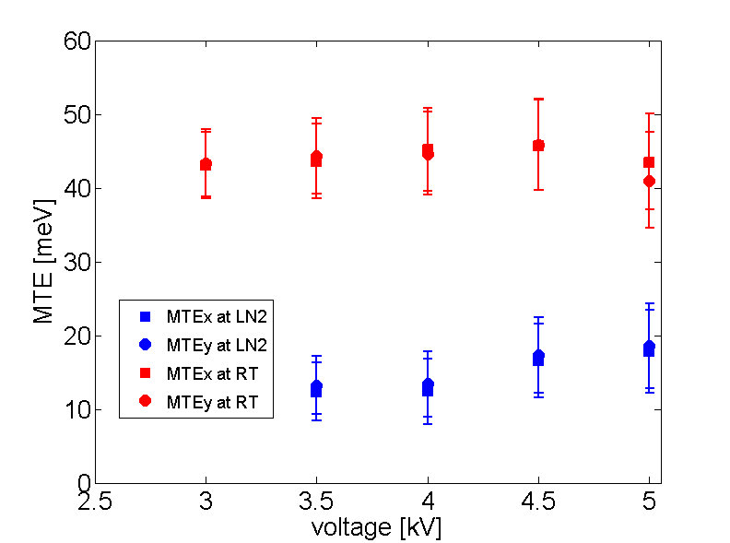
Initial proof that cooling works to reduce beam temperature
Cooling Cs₃Sb to LN2 temperatures
Reached 200K MTE equivalent!
Cryo-cooled HV DC gun now built at Cornell, will be testing cathodes down to ~20K
Cs₃Sb
Cs₃Sb
~0.3 mm mrad
~25 meV at 300 K
~0.17 mm mrad
@ 690 nm
~8 meV at 90 K
PRSTAB 18, 113401 Rev. Sci. Instrum. 86, 073309

Slide 22
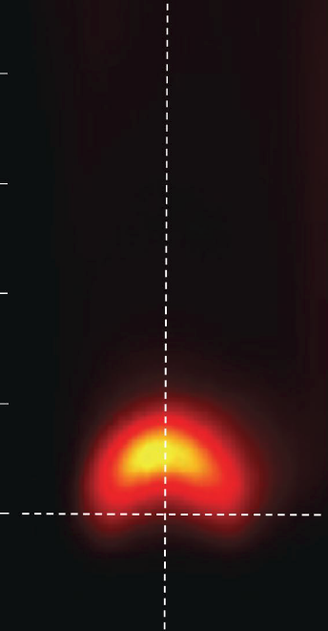
Some promising directions
Ordered photocathodes
Current Status
Existing ordered materials don’t perform as expected
  E.g. activated III-V’s (e.g. GaAs) don’t conserve crystal momentum
Goals
  Screen for new materials
    We don’t need to be limited by nature – design and make materials with desired properties
    Cs-free photoemission
Importance
  Utilize small effective mass to greatly reduce transverse energy spread
-0.1 0 0.1
transverse momentum (Å⁻¹)
0.4
Problem: Cs-F/O activation layer?
0.3
0.2
binding energy (eV)
0.1
0
Localized emission in energy and momentum

Slide 23
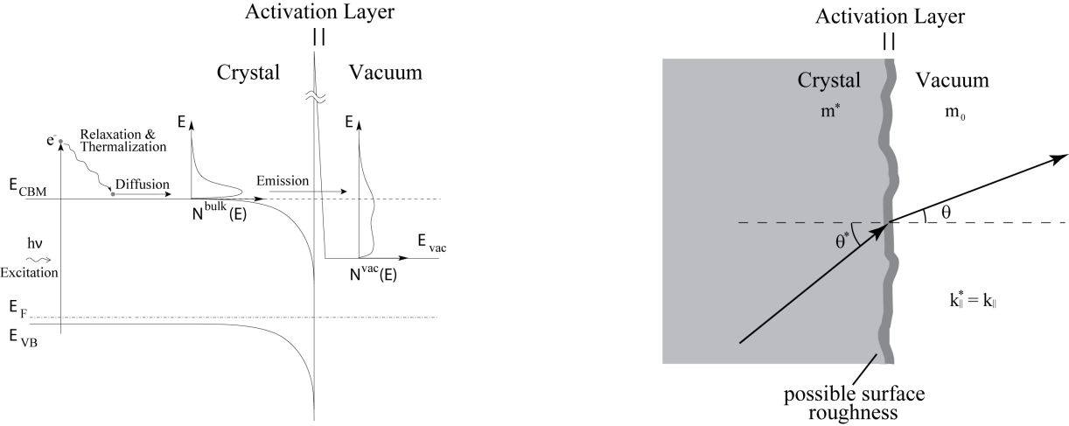
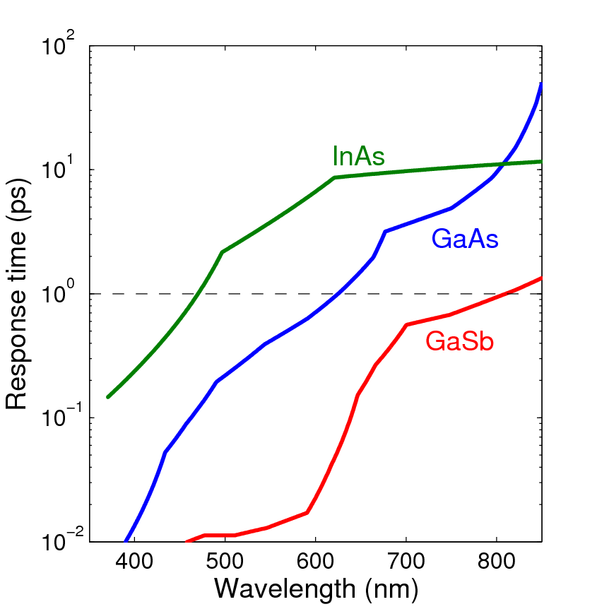
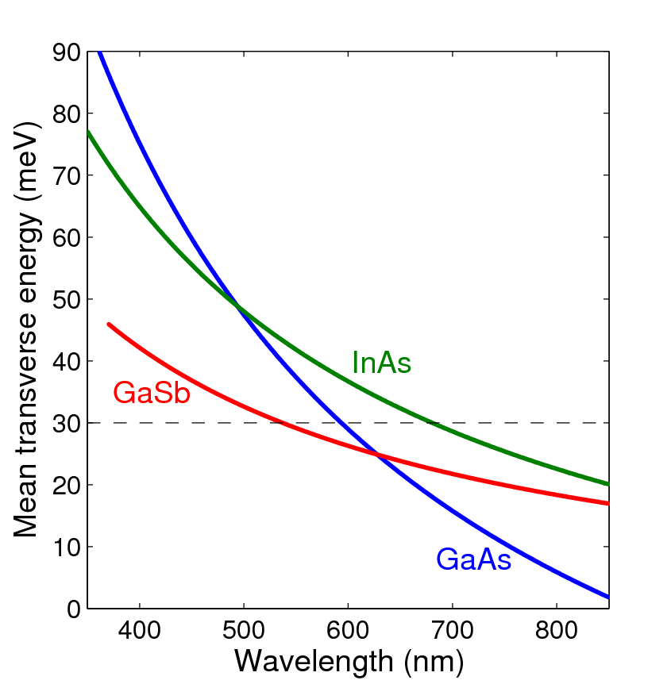
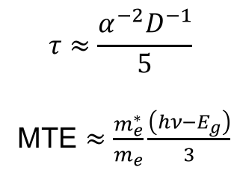
Leveraging the effective mass?
The “narrow cone” has eluded us so far:
Is the surface layer that scatters electron?
Can we prevent this scattering?
Estimates for response time and MTE:
$$τ≈\frac{α^{−2}D^{−1}}{5}$$
MTE $≈\frac{m_{e}^{∗}}{m_{e}}\frac{\left(hν−E_{g}\right)}{3}$

Slide 24
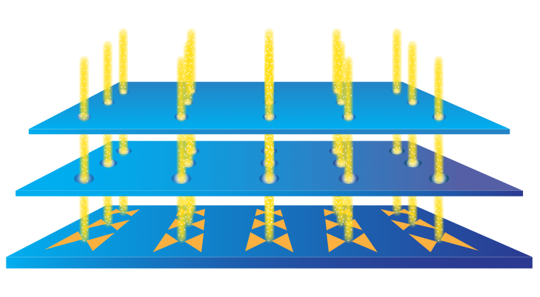
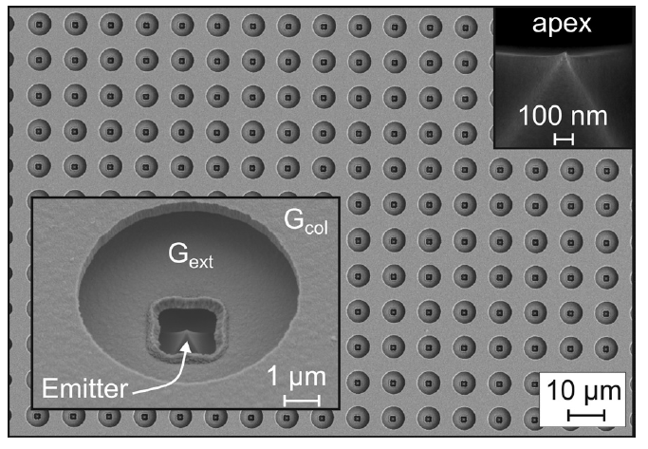
Some promising directions
Sharp tips & arrays
Current Status
Sharp tips & arrays enhance local E-field & reduce emission spot(s)
Goals/Issues
  Single tips with low MTE material
  Plasmonic hole arrays
    microlenses are required to correct divergence
  Integration with e-gun
Importance
  Potential enhancement in brightness by >100
  Can use these field-assisted photoemitters in moderate E-field guns
Alternative nano-array structure: light is coupled from the back
Example of a compact 50kV gun at University of Tohoku
Nanotech. 25, 085203

Slide 25
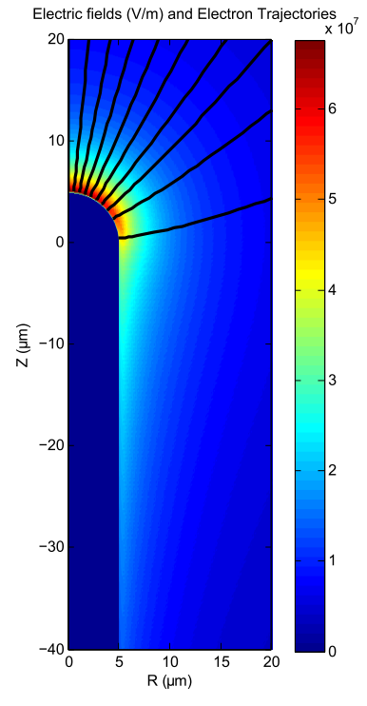
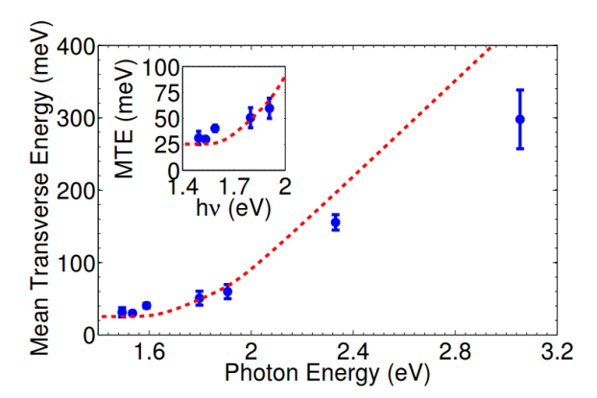
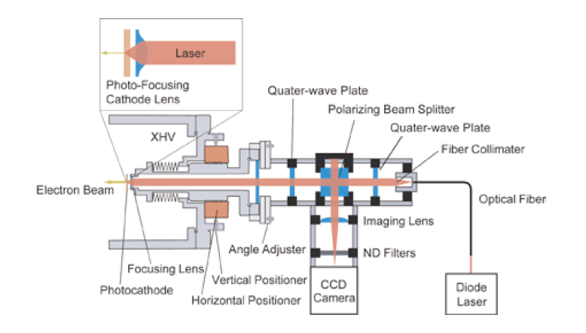
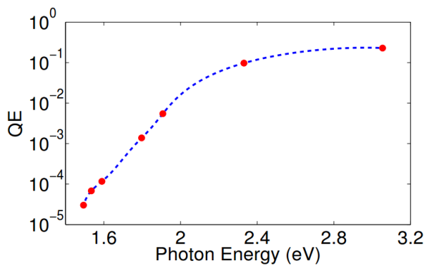
Start with just a single tip (suitable for UED)
Can we combine the following together?
Properly shaped tip to improve the surface field;
A relatively high QE and low MTE photocathode materials;
Operation in transmission mode with sub-um laser spot size

Slide 26
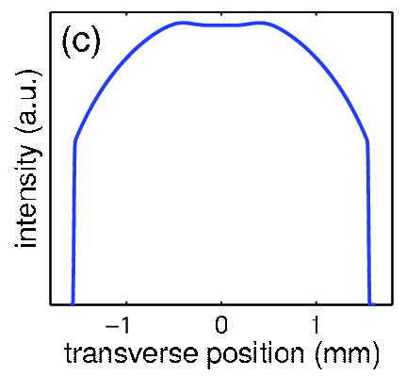
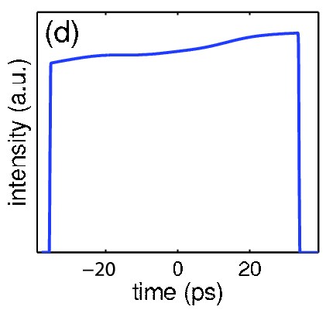
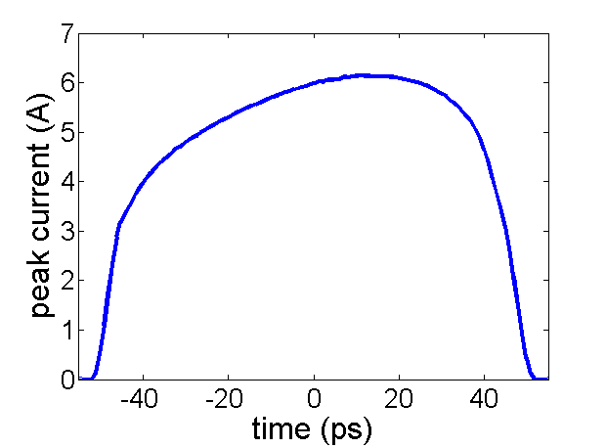
A word on lasers
For lowest MTE’s one needs tunable wavelength lasers;
Desired 3D distribution in free space is a uniformly filled ellipsoid ⇒ linear space charge
Actual ideal laser shape is convoluted by
  The boundary condition of the cathode
  Nonrelativistic energy / bunch compression
  Advanced emittance compensation
desired laser shape
after the gun

Slide 27
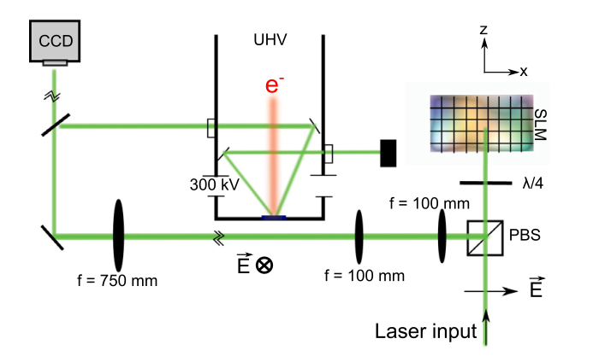
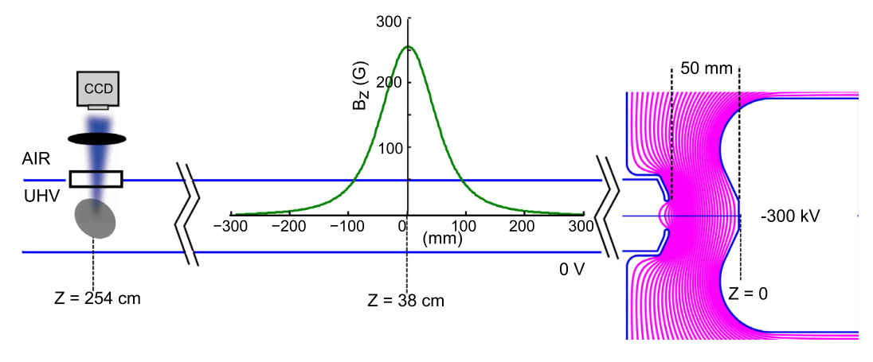
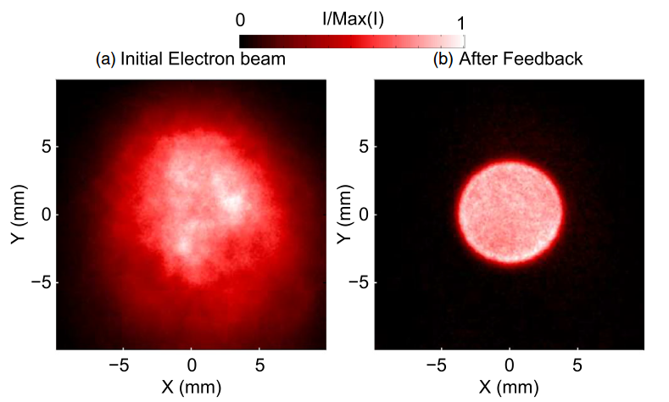
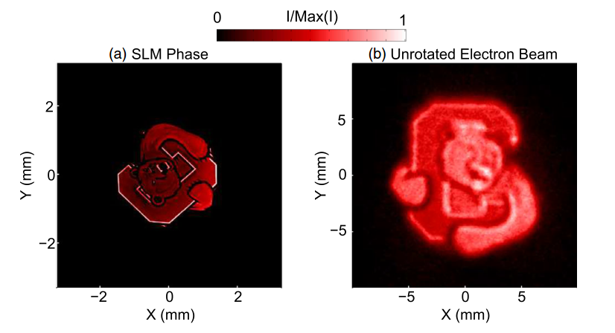
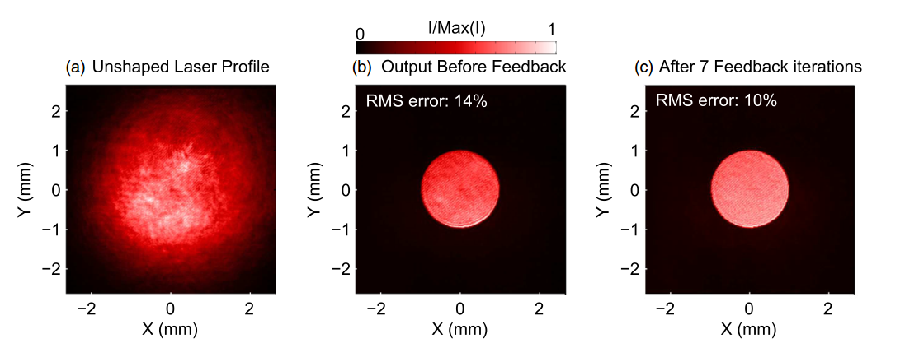
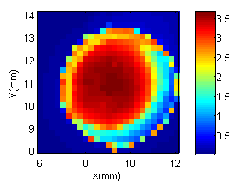
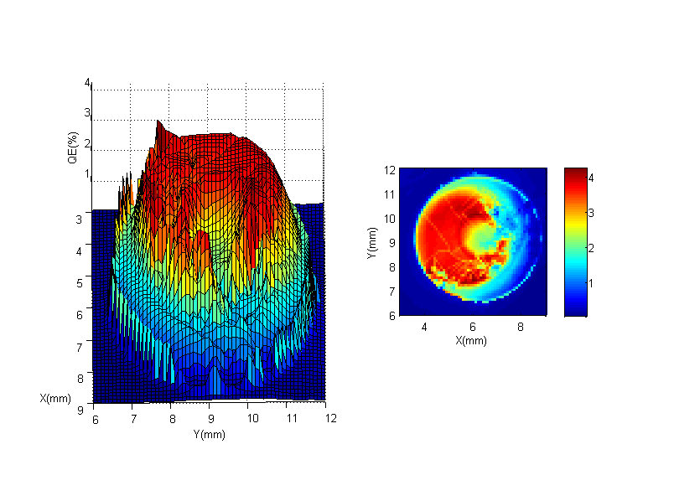
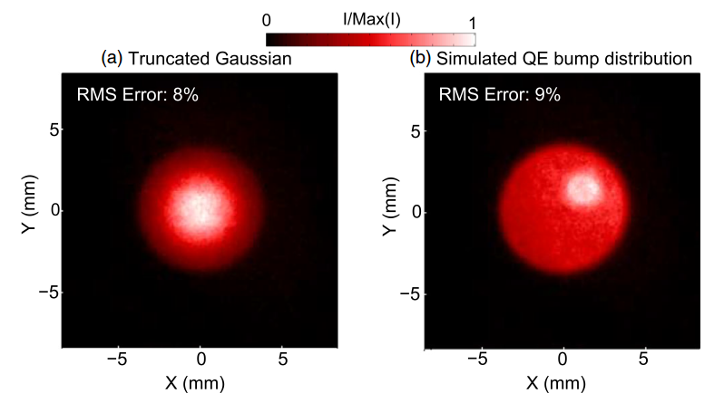
Adaptive transverse shaping
Can also directly shape the e-beam
Damage threshold
2.6 W/cm² average power
100 MW/cm² peak power
Liquid crystal array is used as mask to attenuate the transverse distribution of the laser “point to point” to match the desired profile
fresh
used
Real QE maps
Shape the laser beam
to compensate for QE using e-beam feedback
Easy to implement
Fast feedback
Above 30% efficiency (flat top)
APL 105, 171109
PRSTAB 18, 023401

Slide 28
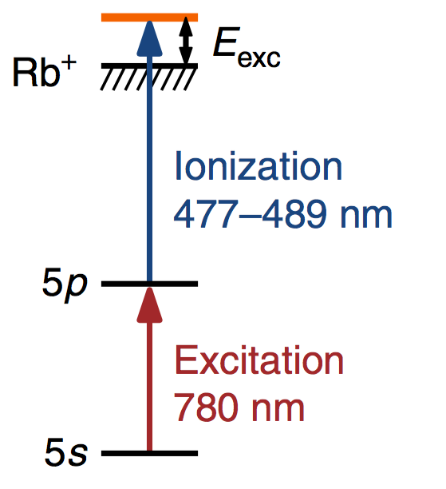
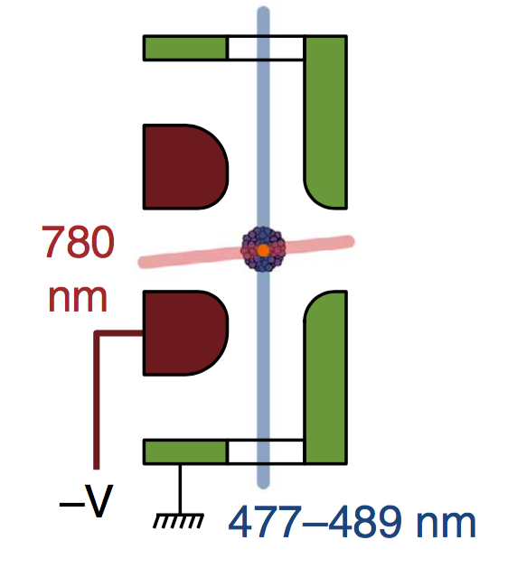

Some promising directions – merging in new ideas
Cold emission from Rydberg states of gases
Current Status
Laser-cooled atoms with narrow energy states
Measured beam temperature: T ~ 30K!
But limited number of electrons per pulse (~10⁴); still should be useful for UED.
Goals
  Integrate magneto-optical trap into the actual accelerating structure to optimize beam properties
Importance
  Potential improvement in brightness by ~100
  New limits to brightness e.g. binary e–e– scattering in the beam
Nat.Comm. 4, 1693
Lasers
Coils
J.Phys.B: AMO Phys. 47, 234009
random electron placement ⇒ beam temperature increase

Slide 29
Summary
Improvement in beam brightness by ~100 is in view;
Principal impact points known & promising directions identified;
Provided the effort and funding momentum is maintained, we should see much progress; breakthroughs possible.

