Slide 1


Using the Omega3P Eigensolver
Nick Valles
Cornell Laboratory for Accelerator-based Sciences and Education

Slide 2
Purpose of Talk
Learn to use the Omega3P eigenmode-solver on Cornell’s systems.
Motivation:
  We can use this package to solve important problems related to the Cornell ERL project.
  Omega3P can handle lossy materials.
  Omega3P is a parallel code.
  Methods used in Omega3P can easily be extended to solving coupled Thermal-EM-Mechanical simulations, Wakefield calculations, multipacting and more.

Slide 3
General Overview
Goal: Compute the eigenmodes of a structure
Finding a system’s eigenmodes requires four steps:
  Construct a model
  Mesh the model
  Run a solver on the mesh
  View the results

Slide 4
Detailed Overview (1 of 2)
Construct a model
  CUBIT can be used, but Autodesk Inventor is better.
  Export a model as a SAT file (v 7.0 or better)
Mesh the model
  Import the model in CUBIT
  Define blocksets (i.e. distinguish volume spaces), and element types (Tet10)
  Define boundary conditions (magnetic, electric, metal)
  Use CUBIT to mesh the model and export GEN file
  Use ACDTOOL to convert GEN to NCDF format

Slide 5
Detailed Overview (2 of 2)
Run a solver on the mesh
  Define an O3P file containing
    Name of mesh file to solve
    Material properties (μ, ε of volumes, metal conductivity, etc.)
    Boundary conditions (which surfaces are metal, electric, etc.)
    Solver methods (Order of Solver, etc.)
    Number of desired Eigenvalues and frequency band
  Write a job submission PBS file and submit to NERSC
View the results
  Copy results to Cornell machine and use Paraview to examine the results

Slide 6
Programs in Tutorial
Connect to remote machines
  Xming-Mesa (for OpenGL support) + PuTTY (for ssh)
File transfers
  FileZilla (for GUI interface), PSFTP (for CL interface)
Meshing
  CUBIT for initial mesh, ACDTOOL for final mesh
Field Solving
  Omega3P
Visualization
  Paraview

Slide 7
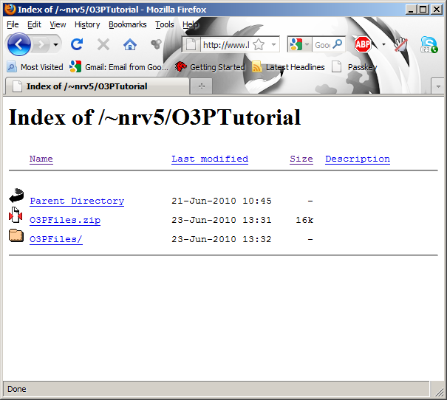
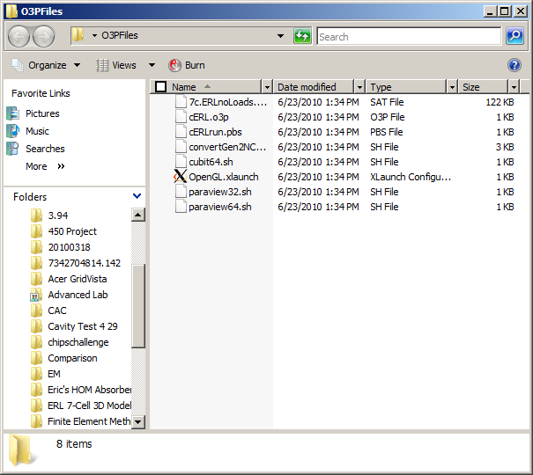
Download Tutorial Files
Download tutorial files to a folder on your local desktop and unzip it http://www.lepp.cornell.edu/~nrv5/O3Ptutorial

Slide 8
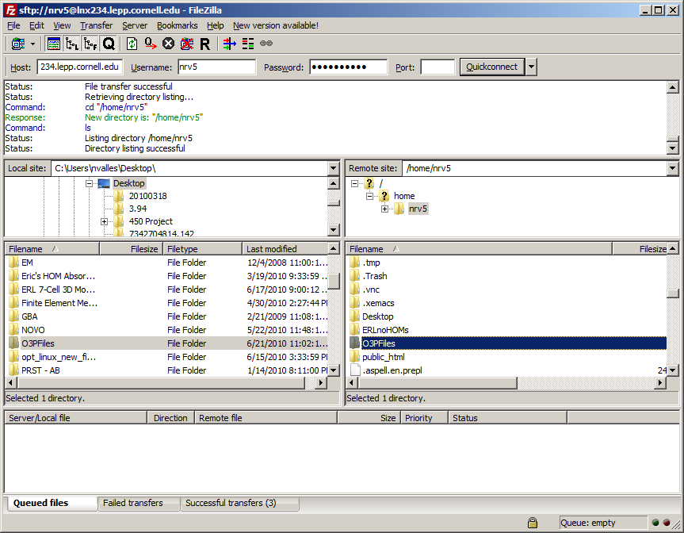
Send Files to Linux Machine
Open your file transfer program.
Login to sftp://lnx234.lepp.cornell.edu with your Cornell username and password
Transfer tutorial files to your Linux home directory

Slide 9

Setup Remote Connection
From tutorial files downloaded from the website, start a remote window service by opening CornellOpenGL.xlaunch with Xming-Mesa
Appears when Xming is running

Slide 10
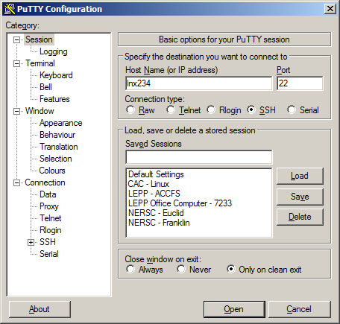
Login to Linux machine
Setup PuTTY to login to lnx234
LNX234

Slide 11
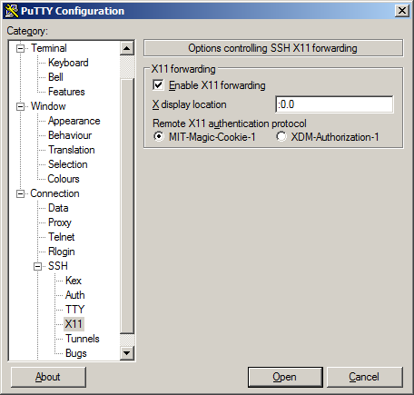
Login to Linux machine
Enable X11 forwarding
:0.0

Slide 12
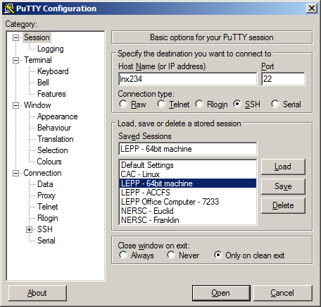
Save configuration.
Login with Cornell ID
Name the machine

Slide 13
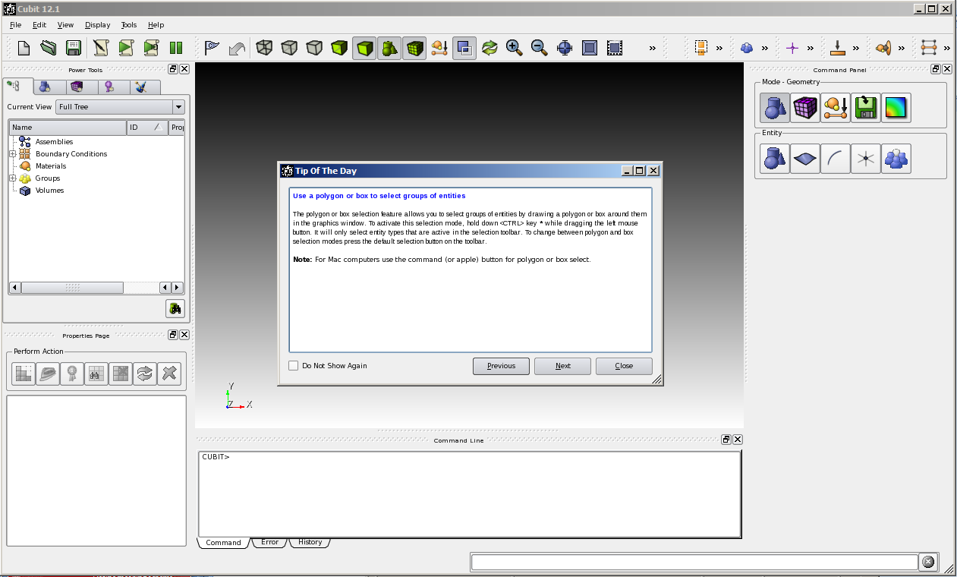
Start CUBIT
Make shell scripts executable
  $ cd O3PFiles
  $ chmod +x *.sh
Start cubit
  $ ./cubit64.sh

Slide 14
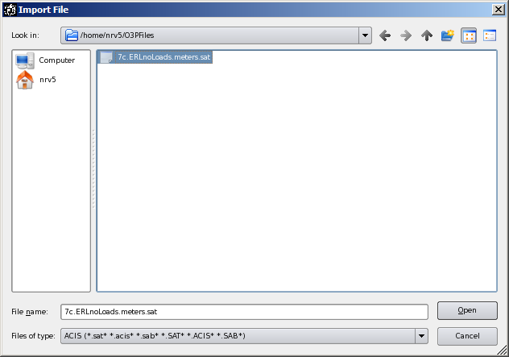
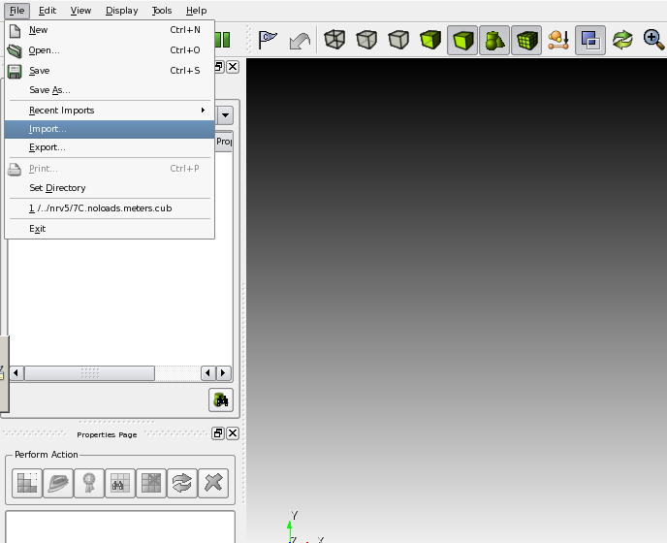
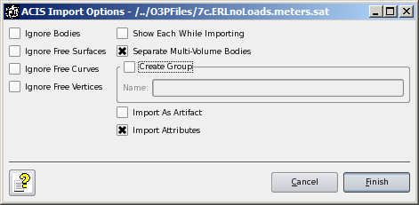
Import SAT model
Import sat model 7c.ERLnoLoads.meters.sat
7c.ERLnoLoads.meters.sat

Slide 15
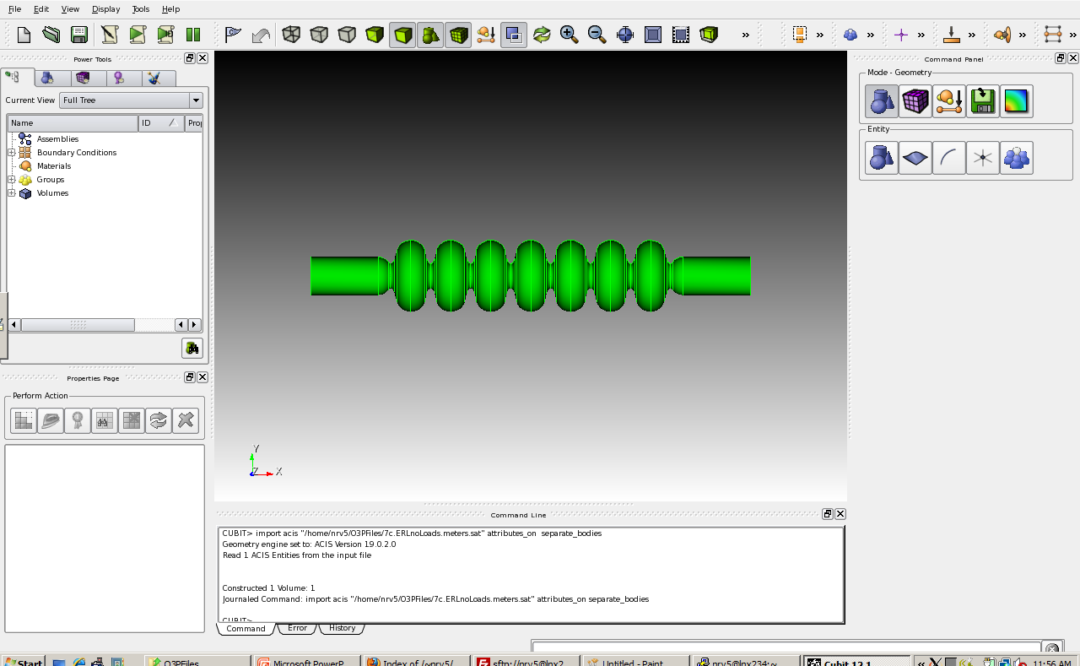
Import SAT model

Slide 16
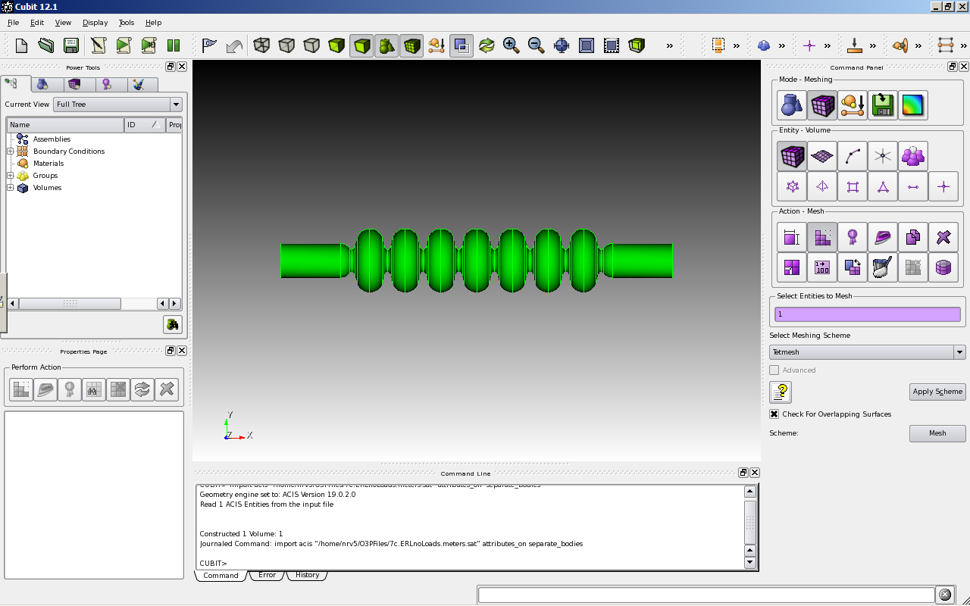
Define meshing scheme
Volume must be named, and element types set
  > volume 1 scheme Tetmesh
1
Tetmesh

Slide 17
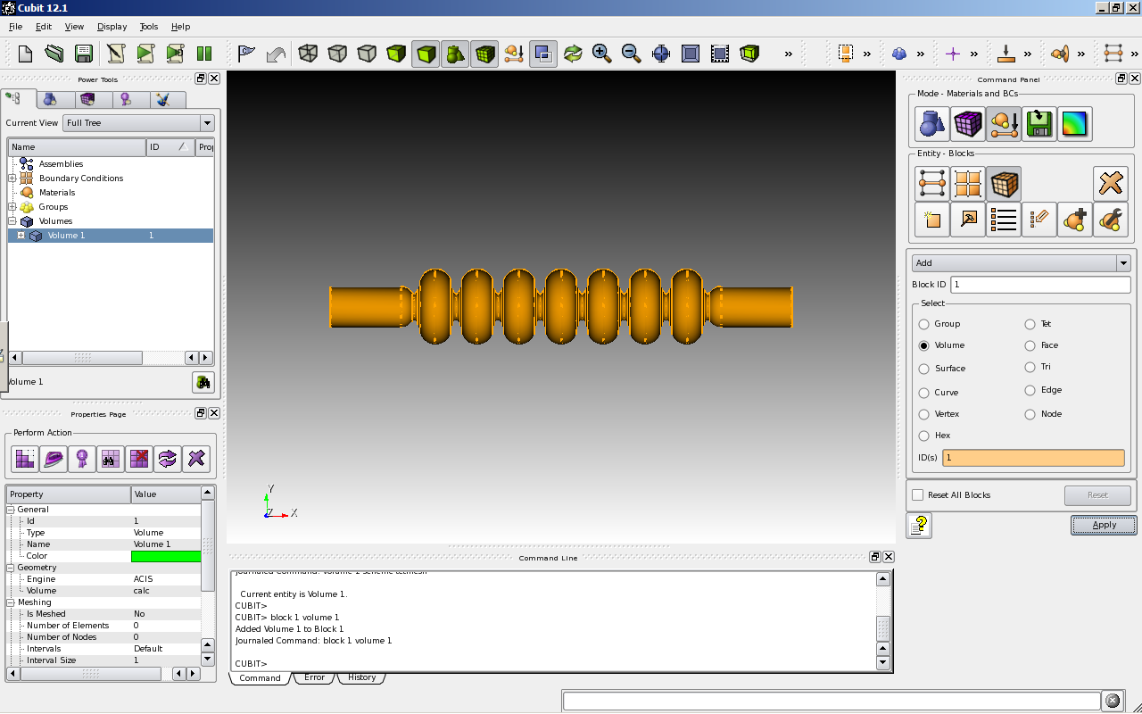
Define Blockset (1 of 2)
Blocksets are used to name volumes
  > block 1 volume 1

Slide 18
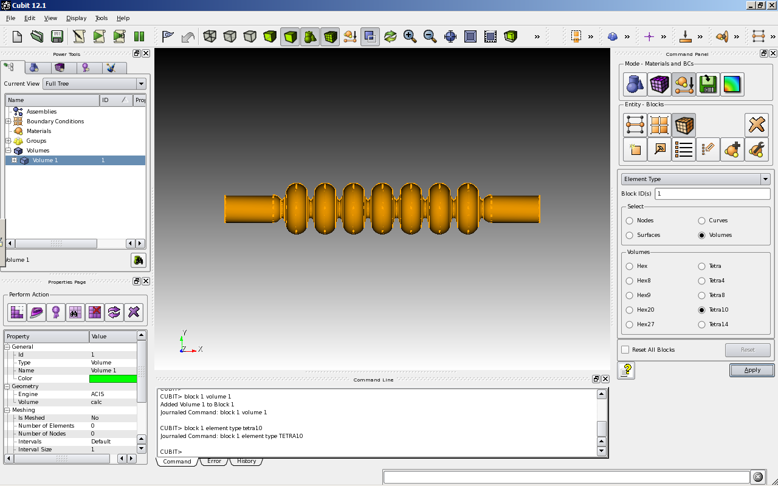
Define Blocksets (2 of 2)
Blocksets also are used to set element type
  > block 1 element type tetra10

Slide 19
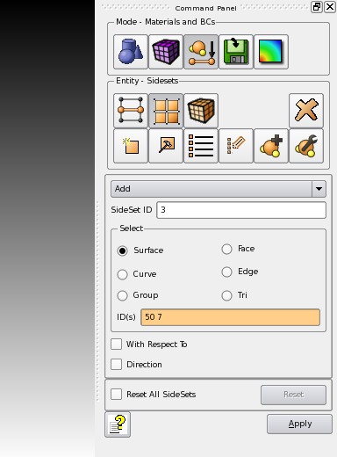
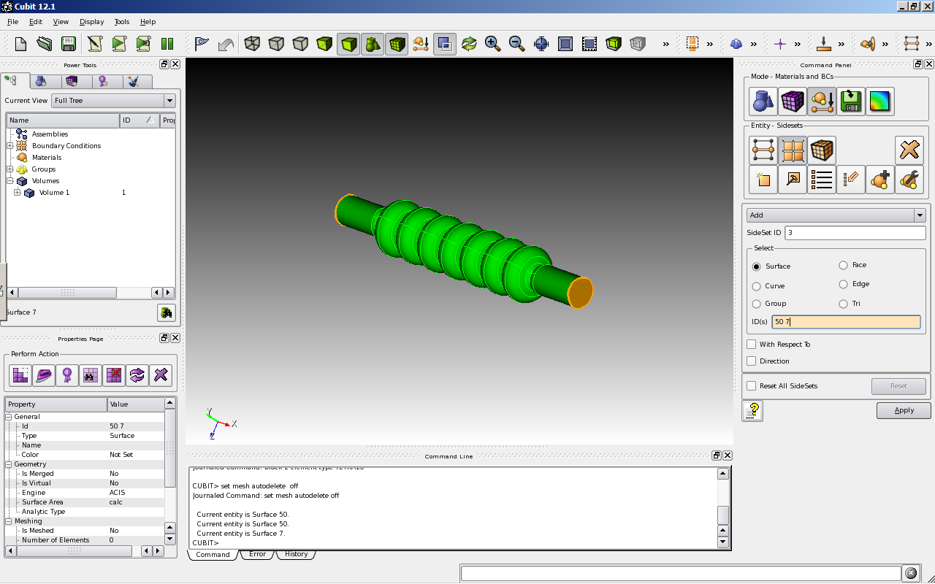
Define Sidesets (1 of 2)
Sidesets are used to define boundaries (magnetic)
  > sideset 3 surface 50 7

Slide 20
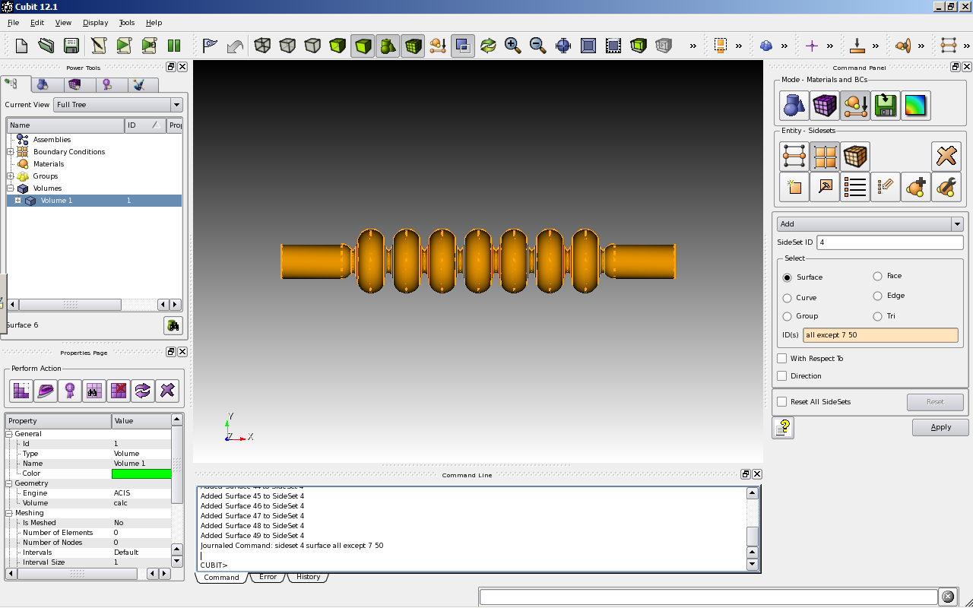
Define Sidesets (2 of 2)
Sidesets are used to define boundaries (Niobium)
  > Sideset 4 surface all except 7 50

Slide 21
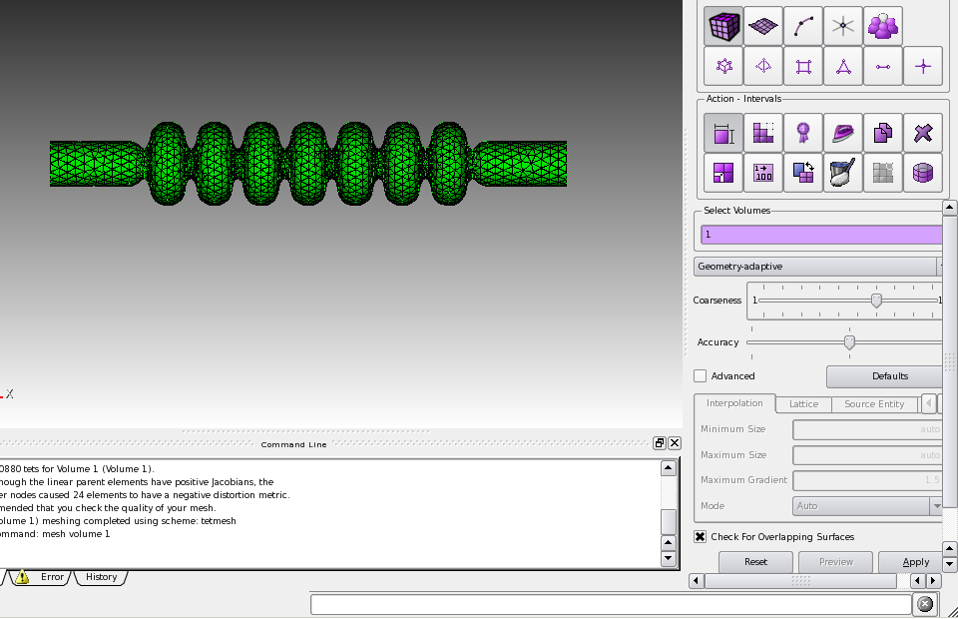
Mesh the volume
We finally mesh the volume
  > volume 1 sizing function type skeleton scale 8 time_accuracy_level 2
  > volume 1 sizing function type skeleton
  > mesh volume 1

Slide 22
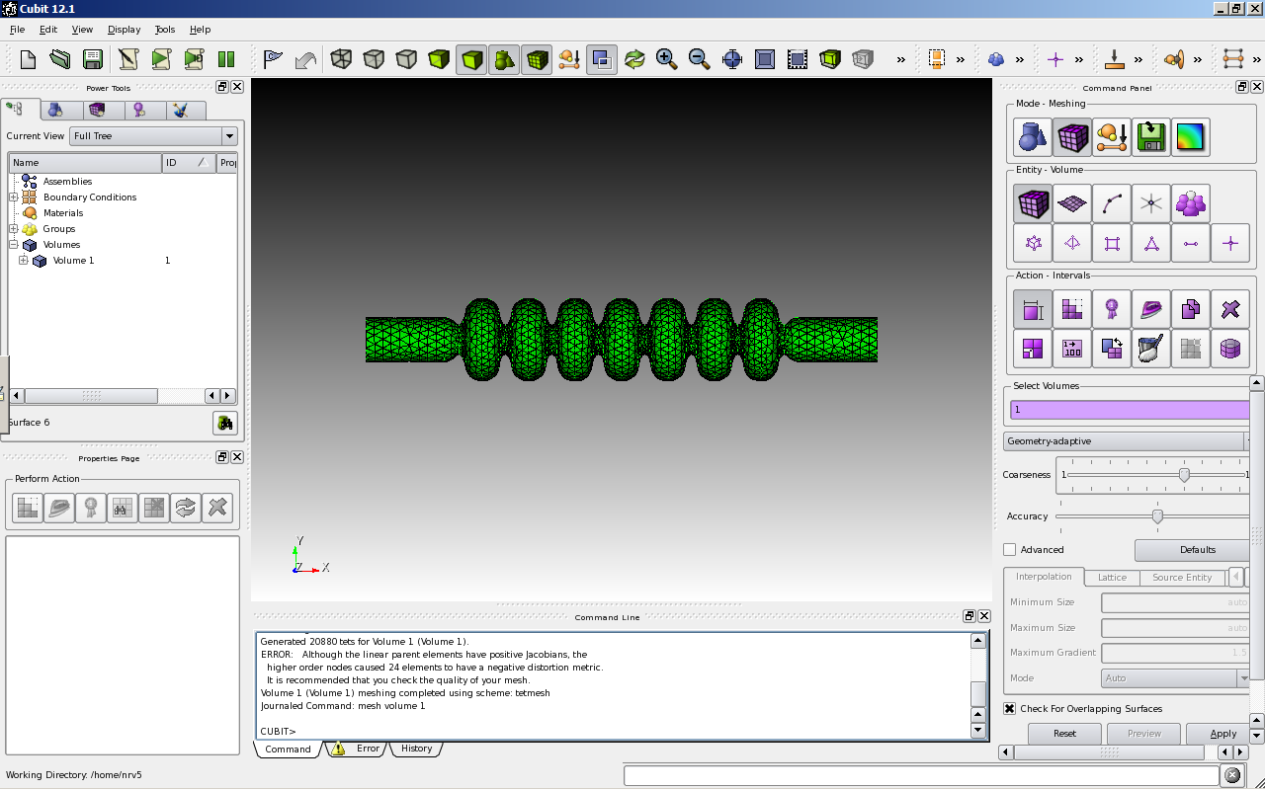
Mesh the volume

Slide 23
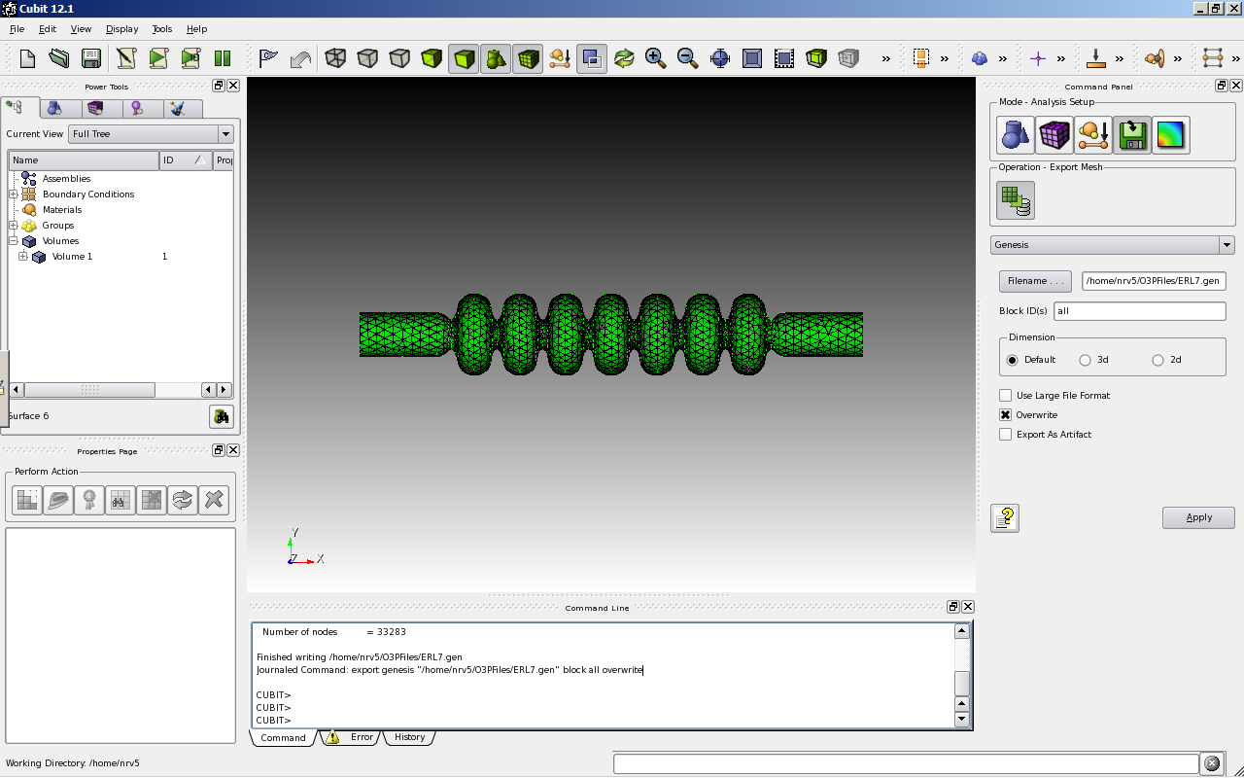
Export the mesh
Export the mesh to Genesis format
  > export genesis "/home/nrv5/O3PFiles/ERL7.gen" block all overwrite
Genesis
all

Slide 24
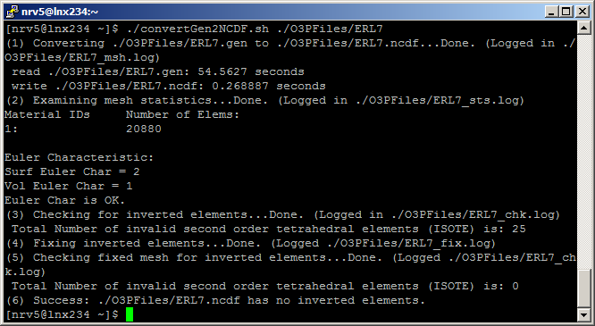
Convert the Mesh to NetCDF
ACDTOOL is a utility provided by Stanford that converts GEN files to NCDF format.
Use convertGEN2NCDF to make the NCDF file.
  $ ./convertGen2NCDF.sh ./ERL7
Notes:
Mesh reads in 1 min and writes in 0.2 s

Slide 25
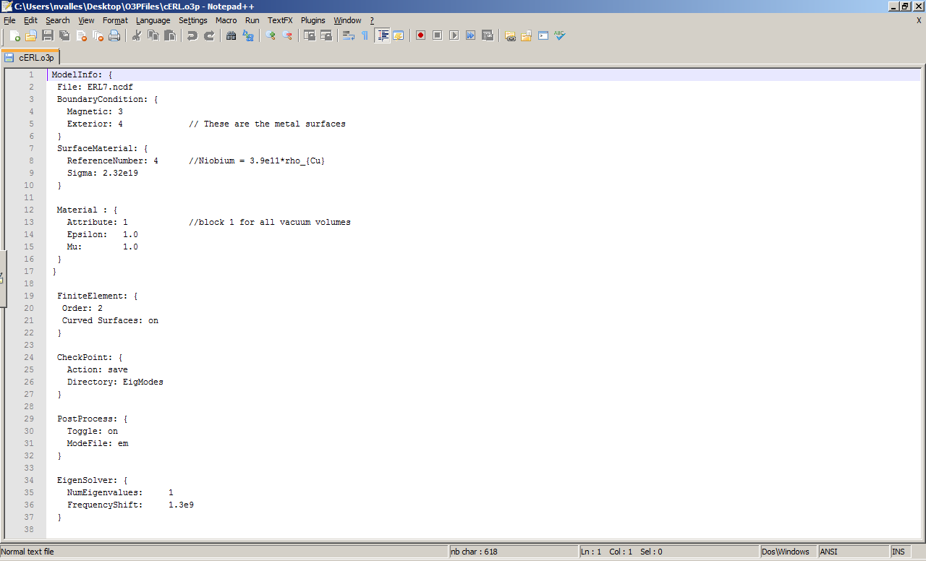
Write the .o3p input file
The .o3p file in the folder controls Omega3p

Slide 26
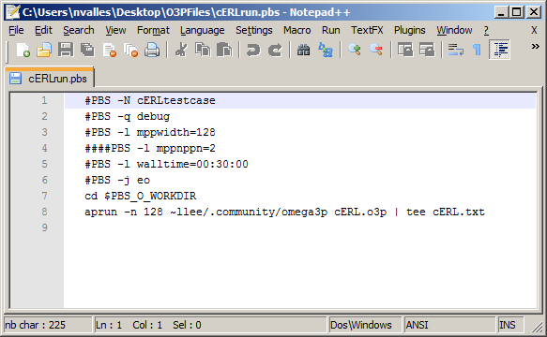
Write the job submission file
The .pbs file directs the NERSC job scheduler

Slide 27
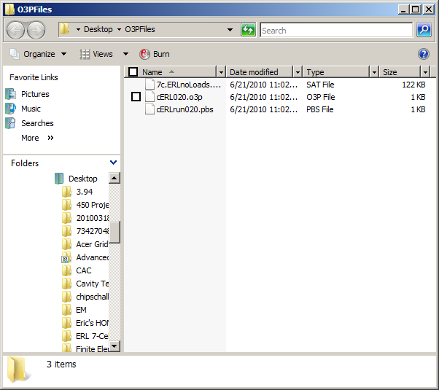
Send Files to Linux Machine
Transfer ERL7.ncdf from your Linux directory directory to your local machine

Slide 28
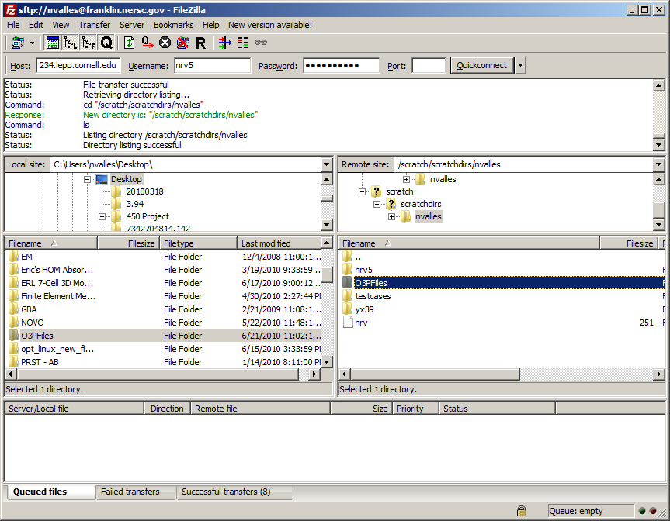
Copy Files to NERSC
Start your file transfer program and connect to sftp://franklin.nersc.gov with your NERSC credentials
Copy the O3P file, the PBS file and the NCDF file to NERSC in the folder
  /scratch/scratchdirs/{your username}/

Slide 29
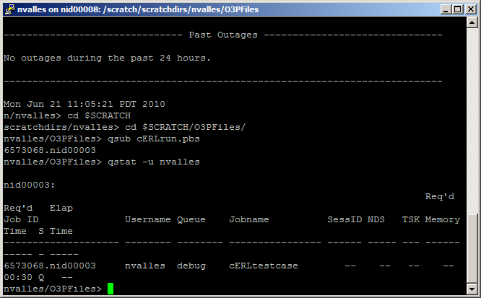
Submit job script
Open PuTTY, and login to franklin.nersc.gov
  > cd $SCRATCH/O3PFiles
  > qsub cERLrun.pbs
  > qstat –u {username}

Slide 30
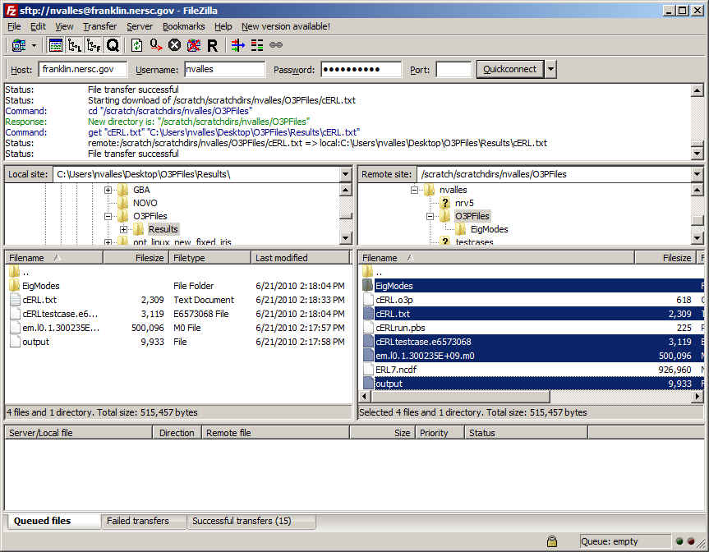
Save results to your computer
After run finishes, log out of PuTTY and transfer the resulting files to your computer

Slide 31
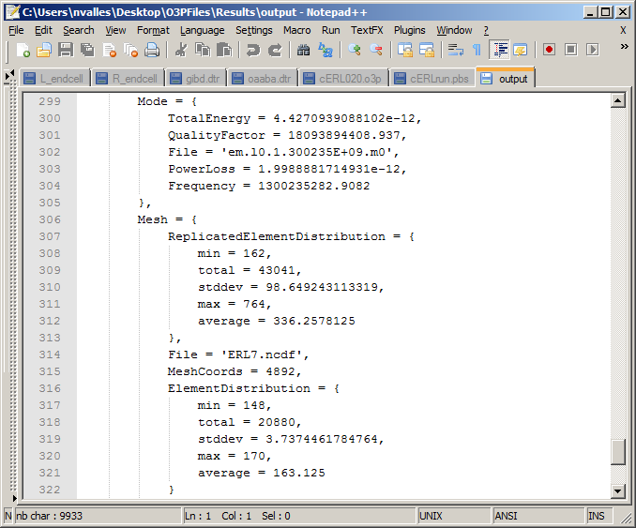
Look at the results
Open output on your local machine
Q_{o} = 1.8e10
f_{o} = 1.3e9

Slide 32
Visualize the Results (1 of 3)
Login to lnx234
Remember to enable port forwarding by checking ‘Enable X11 Forwarding’ and choosing the Xdisplay location as ‘:0.0’
Start paraview with
  > ./O3PFiles/paraview64.sh

Slide 33
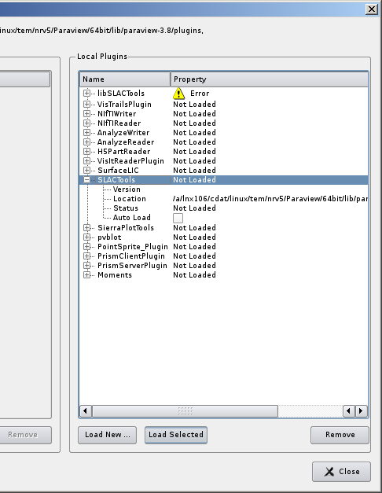
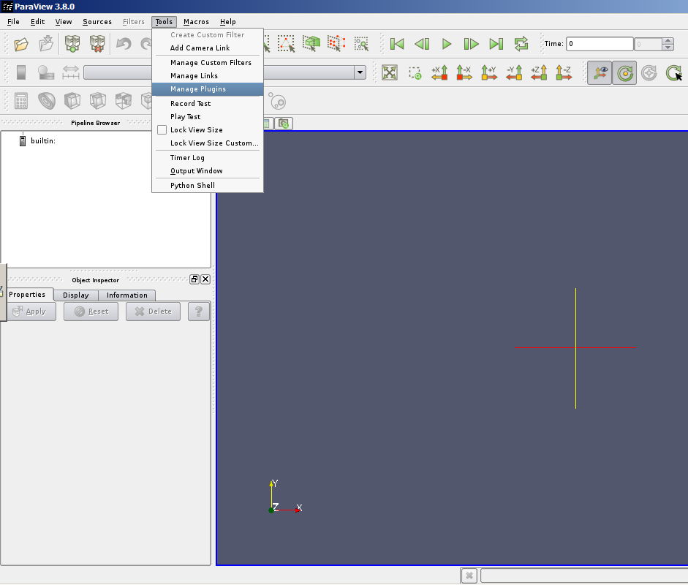
Visualize the Results (2 of 3)
When Paraview starts, enable SLACTools
  Tools > Manage Plugins
  Load SLAC Tools

Slide 34
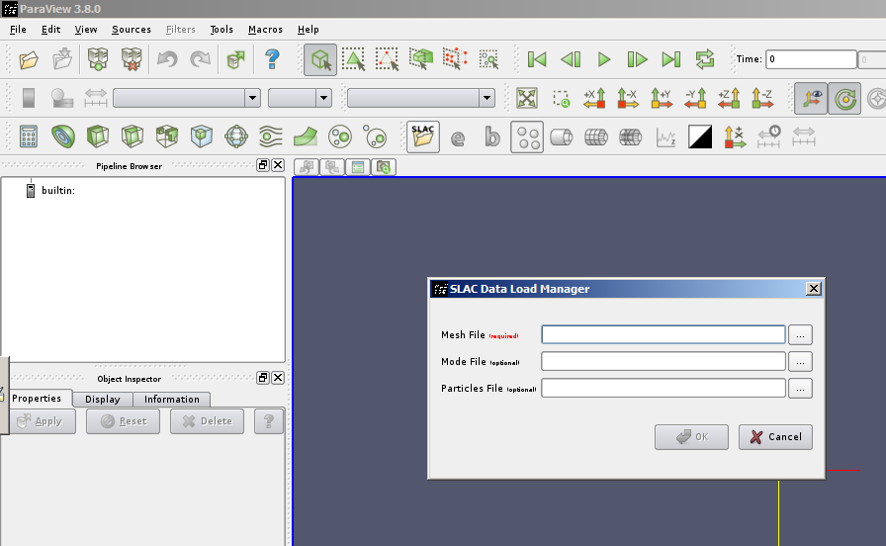
Visualize the Results
Click the ‘SLAC open’ button to load in the results

Slide 35
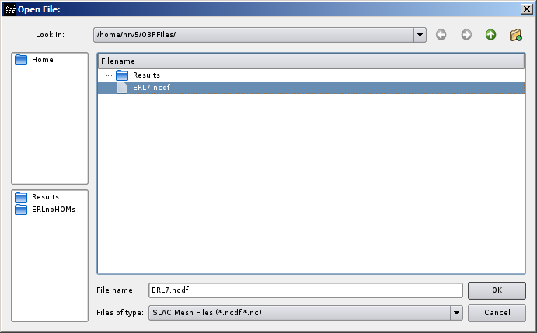
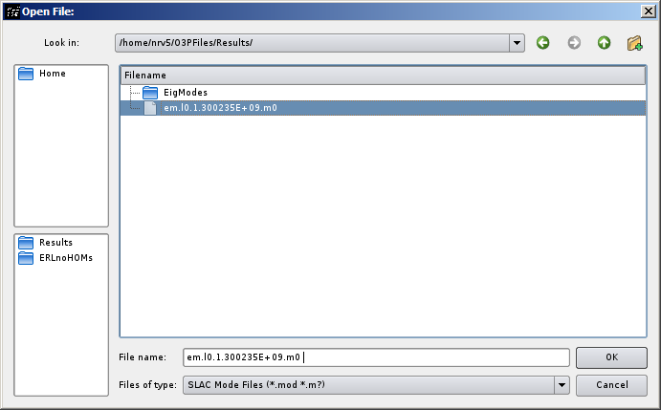
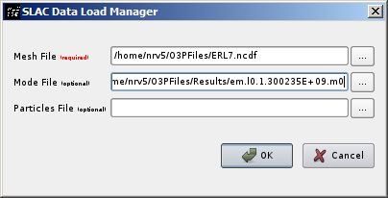
Visualize the results
Load the mesh file
Load the mode file

Slide 36
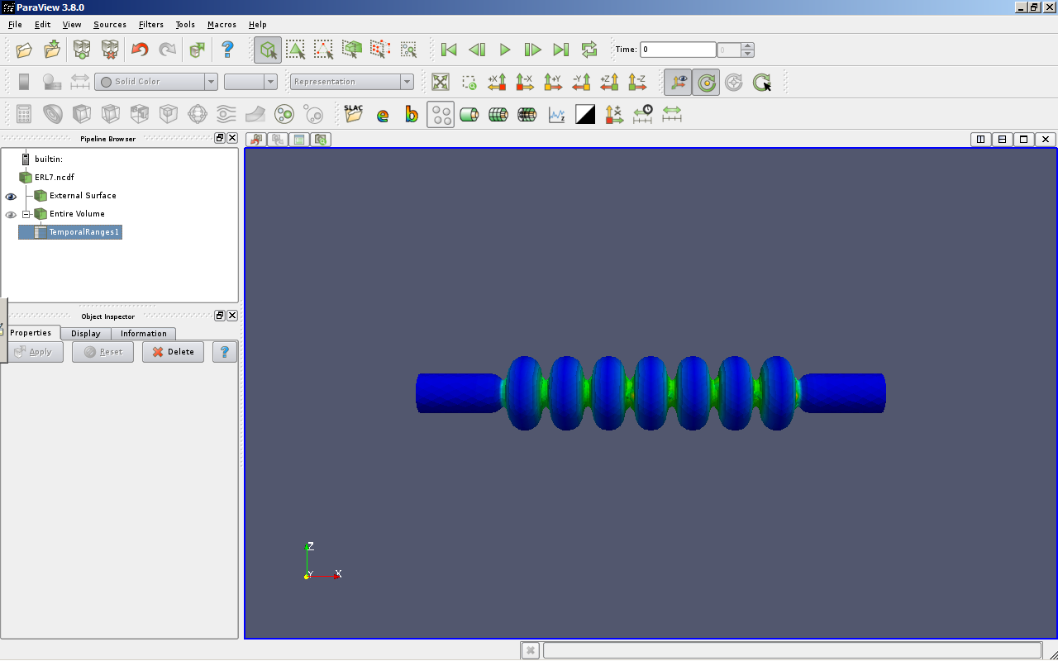
Visualize the results

Slide 37

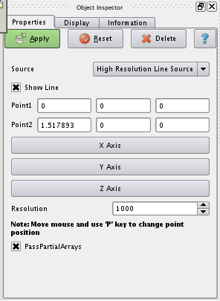
Plot the field profile
Click the field profile plotting button
Define a line along the x-axis
Hit ‘Apply’

Slide 38
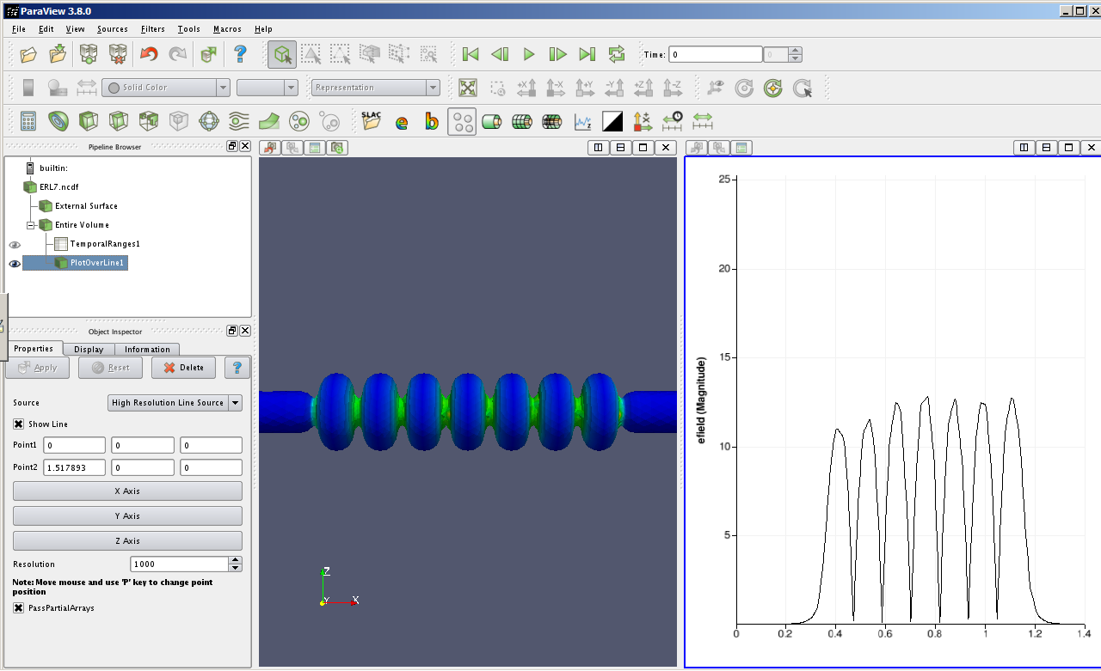
Plot the field profile

Slide 39
Summary
Transfer SAT file to linux
Launch Xming-mesa
Start PuTTY
  Setup PuTTY to connect to a 64-bit linux machine
Login to remote machine
  Make shell scripts executable
Start CUBIT
  Define blocksets and sidesets
  Mesh model
  Export mesh
Use ACDTOOL to convert GEN to NCDF
Write O3P and PBS files
Transfer O3P, PBS and NCDF file to NERSC
Submit the job with qsub {jobname}
Copy the results back to Cornell machine
Use Paraview to visualize solution

